Slide 1

Major Attributes that Distinguish Breast Cancer Whether (M or B)?
MSBA SUMMER 2017
Instructor Dr. Siamak Zadeh
Adarsh Gupta

Slide 2
Overview
Breast Cancer
Introduction to Dataset
Statistical Analyses:
Visualization of Data Pattern (Box Plot)
Co-relation Matrix
Logistic Regression
Hypothesis
Conclusions

Slide 3
Breast Cancer Statistics
One of the main cancer which is on the rise and particularly on rise
Estimated that 1 in 8 women will be diagnosed with invasive type of cancer in upcoming years.
Second most prevalent cancer.
Age group are in between 40-45 and 85 % of women have no family history of this disease
Types: Malignant and Benign
Diagnostic Criteria: Imaging and Blood Testing
Treatment depends upon the type or stage of the cancer
Source: https://www.healthcare.gov/glossary/affordable-care-act/

Slide 4
Introduction to Dataset:
Name: Breast Cancer in Wisconsin State.
Contains Numeric and Categorical data.
Response Variable: Diagnosis (M or B).
Explanatory Variables: radius, area, concavity, smoothness, perimeter, concave etc.
Source of information: www. Kaggle.com
Contains information in the forms of means of each variable.

Slide 5
Visualization of Data Pattern in for each variable using Box Plot

Slide 6
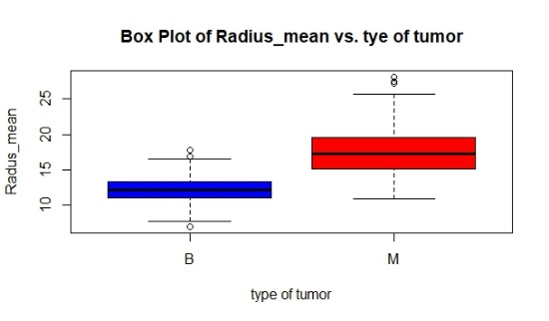
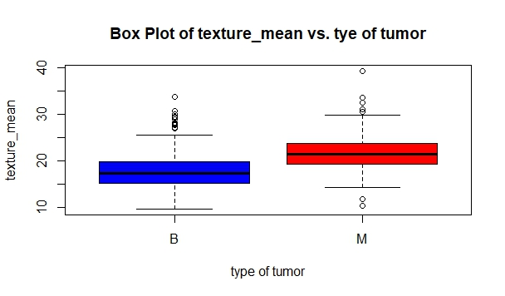
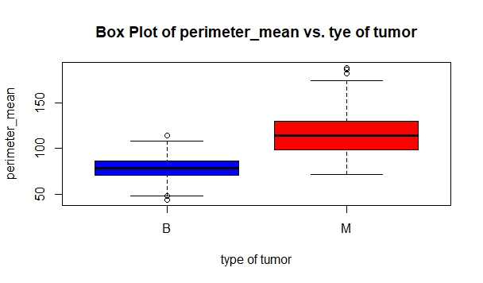
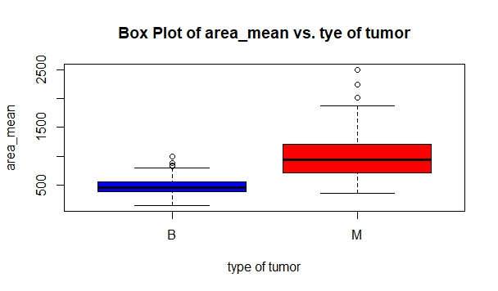

Slide 7
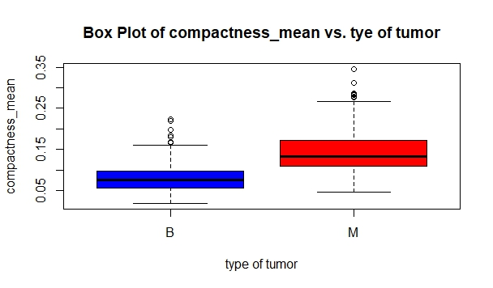
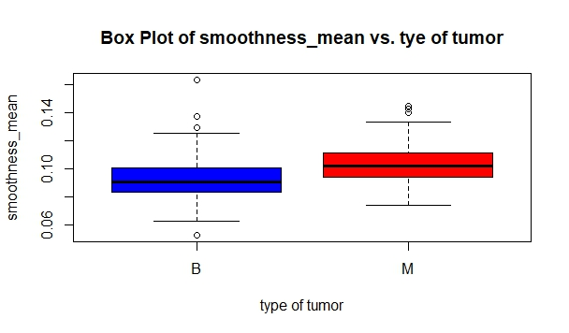
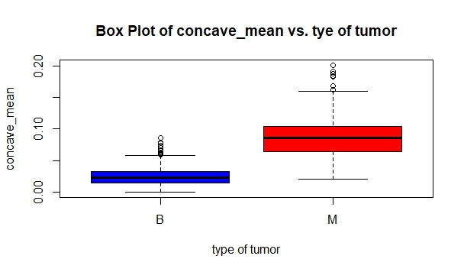

Slide 8
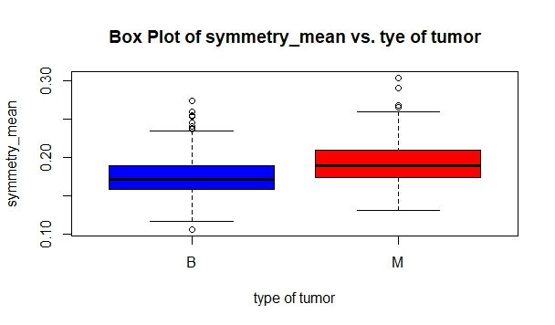
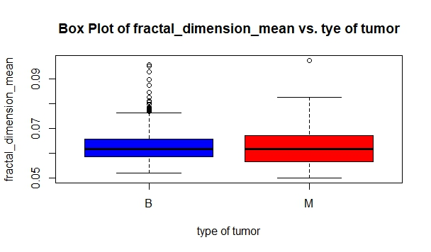

Slide 9
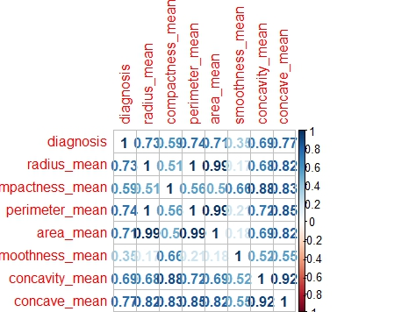

Slide 10
Logistic Regression Model

Slide 11
Regression Result
R square > 1-Null Deviance/Residual Deviance = 0.77 %
Significant variables: Area, Smoothness and Concavity mean
77 percent variation in cancer diagnosis can be explained by area, smoothness and concavity means.

Slide 12
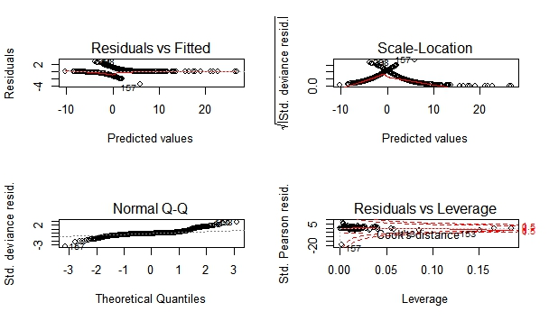
Checking Normality of Variance and Residual Analysis

Slide 13
ANOVA Analysis:
On Area, Smoothness and Concavity mean
Null Hypothesis: There is no mean difference in Malignant and Benign samples of area, smoothness and concavity.
Alt Hypothesis: There is mean difference in Malignant and Benign samples of area, smoothness and concavity.
Fvalue, area= 573.1 ]
Fvalue, smoothness= 83.65 ] P<2e-16
Fvalue, concavity = 533.8 ]
Conclusion: We reject the null hypothesis and conclude that there is mean difference in the number of area, smoothness and concavity sample mean in terms of Malignant and Benign.

Slide 14
Hypothesis using (T Test)
We want to determine if the mean of Malignant sample of Area, smoothness and concavity different from the mean of Benign sample.
H_{0:} The mean difference in Malignant sample of area is not less than the Benign one.
H₁: The mean difference in the Malignant sample of area is less than the Benign one
In order to test the hypothesis above, we performed t-Test Analysis.
t.test(area_mean~diagnosis,alt="less",data=bc)

Slide 15
T Test Result
At p value<2e-16, we reject null hypothesis and conclude that the mean difference in malignant and Benign is less than zero.

Slide 16
Conclusions
After performing our descriptive statistic and regression analysis, we concluded the following:
Area, smoothness and concavity mean can be used to tell the difference in between malignant ad benign tumor.
About 70 percent of variation in malignant and benign can be explained by area, smoothness and concavity mean being 30 percent unexplained through regression model but there may be some higher chances of model accuracy if it is to be checked by some other methods such as NN, forest model.
From the hypothesis part, it is concluded that the mean difference in area, smoothness and concavity mean exists between the samples and we are 95 percent confident that it would als be exist in the population mean.

Slide 17
THANKS
Eat Healthy, Live Healthy
Prevention is better than Cure

